Slide 1
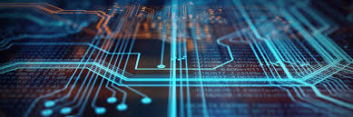
Computer
Made by Himanshi

Slide 2
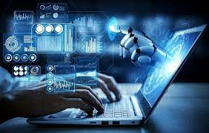
What is a computer??
A computer is a machine that can be programmed to automatically carry out sequences of arithmetic or logical operations (computation). Modern digital electronic computers can perform generic sets of operations known as programs. These programs enable computers to perform a wide range of tasks.

Slide 3
HISTORY OF COMPUTER
One of the earliest and most well-known devices was an abacus. Then in 1822, the father of computers, Charles Babbage began developing what would be the first mechanical computer. And then in 1833 he actually designed an Analytical Engine which was a general-purpose computer.

Slide 4
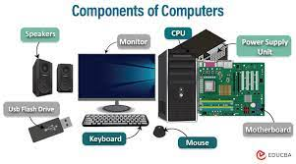
Component of Computer
A computer is an electronic device that accepts data, performs operations, displays results, and stores the data or results as needed. It is a combination of hardware and software resources that integrate together and provides various functionalities to the user. Hardware is the physical components of a computer like a processor, memory devices, monitor, keyboard, etc., while software is a set of programs or instructions that are required by the hardware resources to function properly.

Slide 5

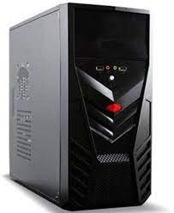
CPU BRAIN OF THE COMPUTER
Central Processing Unit (CPU) The CPU is the brain of a computer, containing all the circuitry needed to process input, store data, and output results. The CPU is constantly following instructions of computer programs that tell it which data to process and how to process it.

Slide 6
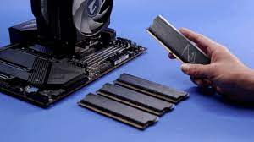
COMPUTER MEMORY
Computer memory stores information, such as data and programs, for immediate use in the computer.^{[2]} The term memory is often synonymous with the terms RAM, main memory or primary storage. Archaic synonyms for main memory include core (for magnetic core memory) and store.^{[3]}
Main memory operates at a high speed compared to mass storage which is slower but less expensive per bit and higher in capacity. Besides storing opened programs and data being actively processed, computer memory serves as mass storage cache and write buffer to improve both reading and writing performance. Operating systems borrow RAM capacity for caching so long as not needed by running software.^{[4]} If needed, contents of the computer memory can be transferred to storage; a common way of doing this is through a memory management technique called virtual memory.
Modern computer memory is implemented as semiconductor memory,^{[5][6]} where data is stored within memory cells built from MOS transistors and other components on an integrated circuit.^{[7]} There are two main kinds of semiconductor memory: volatile and non-volatile. Examples of non-volatile memory are flash memory and ROM, PROM, EPROM and EEPROM memory. Examples of volatile memory are dynamic random-access memory (DRAM) used for primary storage, and static random-access memory (SRAM) used mainly for CPU cache.
Most semiconductor memory is organized into memory cells each storing one bit (0 or 1). Flash memory organization includes both one bit per memory cell and multi-level cell capable of storing multiple bits per cell. The memory cells are grouped into words of fixed word length, for example, 1, 2, 4, 8, 16, 32, 64 or 128 bits. Each word can be accessed by a binary address of N bits, making it possible to store 2^{N} words in the memory

Slide 7
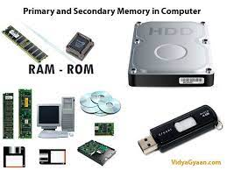
PRIMARY MEMORY
Primary memory is the memory that the CPU can access directly; that is, data values can be read from and written to primary memory using a unique address for each memory location. Primary memory is volatile (it will lose its contents if power is turned off) and comprises the CPU's registers and cache memory and RAM.

Slide 8
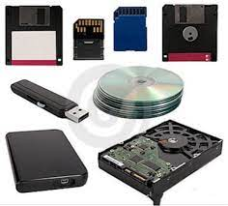
SECONDARY MEMORY
Secondary memory is where programs and data are kept on a long-term basis. Common secondary storage devices are the hard disk and floppy disks. The hard disk has enormous storage capacity compared to main memory. The hard disk is usually contained in the systems unit of a computer.

Slide 9
Types of Computer Devices
Types of devices:
Smartphones
A smartphone is a handheld mobile phone with a touch screen, that can be used to access the internet. A smartphone is a great way to access the internet when you are out and about, but the small screen size means it is hard to do prolonged or detailed tasks on them.
Tablets
Tablets are portable computers, that look almost like a large smartphone. They operate through their touch screen which can vary in size, there is no physical keyboard. Tablets are a good option for looking at the internet when you are out and about, or when sitting in a comfy chair, but can be frustrating to write long messages on!
Laptops
Laptops are computers that fold down flat so they can be transported easily- great for using on the train or if you don’t have a permanent desk space. They vary in size from about 8 – 17inch screens, and they have keyboards, which makes them most suited to using at a desk. Some laptops have touch screens as well as keyboards, which allows them to be used in a similar way to a tablet.
Desktops
These are perhaps the device people think about when they hear the word computer. They are non-portable devices with a screen and keyboard. They are great if you want a home computer that doesn’t move, as you can have a large screen, keyboard and a mouse. In some desktops the computer screen contains the computing device- these are called all-in-ones.

Slide 10
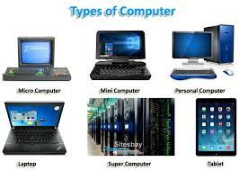
TYPES OF COMPUTER
There are many different types of computers, but here are 7 of the most common Computer: Supercomputers, Mainframe computers, Minicomputers, Personal computers (PCs), Workstation computers, Microcontrollers & Smartphones.

Slide 11
GENRATION OF COMPUTER
The generations of computers are typically divided into five distinct phases: First Generation (1940-1956): Vacuum Tubes. Second Generation (1956-1963): Transistors. Third Generation (1964-1971): Integrated Circuits. Fourth Generation (1971-Present): Microprocessors.
First Generation Computers (1940-1956)
Second Generation Computers (1956-1963)
Third Generation Computers (1964-1971)
Fourth Generation Computers (1971-Present)
Fifth Generation Computers (Present and Beyond)

Slide 12
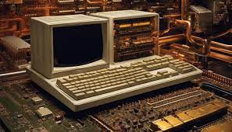
FIRST GENERATION OF COMPUTER
The first generation of computers is generally known as electromechanical computers or using vacuum tubes. For example, ENIAC has used Vacuum tubes, relied on Machine Language and Boolean logic. A computer using vacuum tubes is very slow in executing programs compared to present-day computers.
The ENIAC (Electronic Numerical Integrator and Computer) aka "the Giant Brian" (1945) was the first electronic general-purpose digital computer.

Slide 13
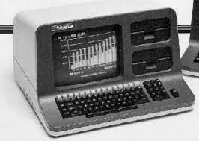
SECOND GENERATION OF COMPUTER
The second generation of computers is a term used to describe a group of computers that were developed in the late 1950s and 1960s. These computers replaced vacuum tubes with transistors. Thus, making them smaller, faster, and more efficient.12 Apr
A transistor computer, now often called a second-generation computer, is a computer which uses discrete transistors instead of vacuum tubes. The first generation of electronic computers used vacuum tubes, which generated large amounts of heat, were bulky and unreliable.

Slide 14
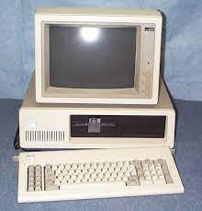
THIRD GENERATION OF COMPUTER
Third-generation computers used integrated circuits in place of transistors. With the use of integrated circuits, these computers became reliable, generated less heat, were small in size, fast, very less maintenance, and were inexpensive. It was developed in 1958 by Robert Noyce and Jack Kilby.
The features were: reliability, lesser production of heat, low maintenance, reduction in size, less consumption of power, high-level language was used, use of integrated circuits, faster, more efficient multiprogramming OS was supported.

Slide 15
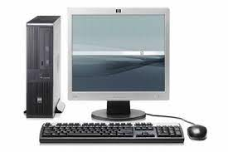
FOURTH GENERATION OF COMPUTER
The fourth generation lasted from 1971 to 1980.Semiconductor memories have taken the place of magnetic core memory. During this time, computer operating institutions were designed. Users benefitted from the usage of Graphic User Interface technologies. During this time, PCs became more inexpensive and widespread.
These computers used the VLSI technology or the Very Large Scale Integrated (VLSI) circuits technology. Therefore they were also known as the microprocessors. Intel was the first company to develop a microprocessor.

Slide 16
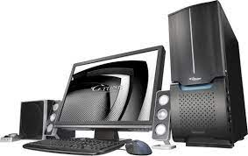
FIFTH GENERATION OF COMPUTER
The Fifth Generation computers are defined as the computers which will be used predominantly in 1990s. Supercomputers will be used in scientific and engineering calculations and simulations. Database machines and present mainframe computers will be networked in order to organise worldwide information systems.
The objective is a machine with 10 billion floating point operations a second (10 GFLOPS) and one billion bytes memory with a speed of 1.5 billion bytes a second.

Slide 17
CONCLUDING
As you have seen, computers are an exciting addition to the writing process. ... Computers are a resource, just as there are many different writing resources, and should be used as such. They are an undisputedly important tool to the writer, but you cannot complete a project with just one tool Computers are great for learning and getting information from the internet. But we should be careful online to avoid bad stuff. In the end, computers have changed our lives and made many things easier.

